Slide 1
Field of View visualization

Slide 2
Field of view visualization for CVE
Hindmarsh et al. (1998) [8] propose to make the view frustrum visible as awire-frame or by highlighting viewed objects in some way (perhaps using lightingor shadows).
Fraser et al. (1999) [5] decided to explicitly outline the view frustrum usinga wire-frame to affirm the view of the other collaborator. The choice of notusing lightnings is because lightnings was often used in virtual environmentsfor cosmetic or realism reasons.
Nguyen and Duval (2015) [10] suggest that a problem that may arise when using view frustrums: when there are many collaborators working in the same narrow space, the confusion of these “wire-framed” representations can happen.
Cordeil et al. (2017) [3] utilize the visual frustrum visualization for a collaborative VR environment as a replacement for avatars.
Piumsomboon et al. (2017) [12] implement a CVE for mix device collab-oration AR/VR in which field of view visualizations are display to facilitate understanding of what is visible to a collaborator using a different device. Wong and Gutwin (2010) [17] highlight how the visual frustrum visualiza-tion can be beneficial in pointing based communication by facilitating mutualawareness of visual focus and therefore the ability to produce pointing gesturesthat are visible to collaborators
Wong and Gutwin (2014) [18] suggest that Hindmarsh proposed improve-ments including visual frustrum have not, in general, being implemented in the state of the art CVE.

Slide 3
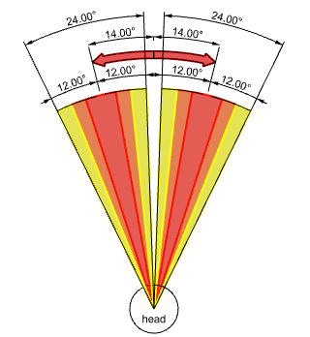
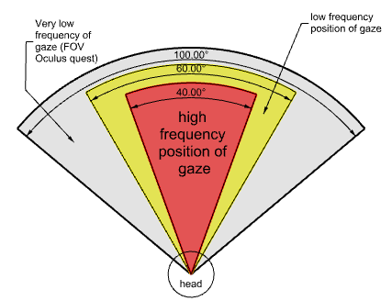
Cone of vision
The eyes have a physical range of 50°, it has been found that they rarely rotate beyond 30°relative to the head [9] and are more frequently within 20°[9, 7, 6].
Further work highlight how within the20°of gaze amplitude there are areas with a much higher frequency of gaze: Sitzmann et al. (2016) [16] work on visual saliency observed a mean gaze direction of around 14±12°relative to the head orientation Fig 1b.
[9] M. Land and B. Tatler. Looking and Acting: Vision and eye movements in natural behaviour. Oxford University Press, 3 2012.ISBN 9780191693878.doi:10.1093/acprof:oso/9780198570943.001.0001.
[6] E.G.Freedman.Coordinationoftheeyesandheaddur-ingvisualorienting,102008.ISSN00144819.URL/pmc/articles/PMC2605952/ /pmc/articles/PMC2605952/?report=abstracthttps://www.ncbi.nlm.nih.gov/pmc/articles/PMC2605952/.
[7] H. H. Goossens and A. J. Van Opstal.Human eye-head coordination intwo dimensions under different sensorimotor conditions.Experimental Brain Re-search, 114(3):542–560, 1997.ISSN 00144819.doi: 10.1007/PL00005663.URLhttps://pubmed.ncbi.nlm.nih.gov/9187290/.
[16] V. Sitzmann, A. Serrano, A. Pavel, M. Agrawala, D. Gutierrez, B. Masia, andG. Wetzstein.How do people explore virtual environments?2016.URLhttp://arxiv.org/abs/1612.04335.

Slide 4
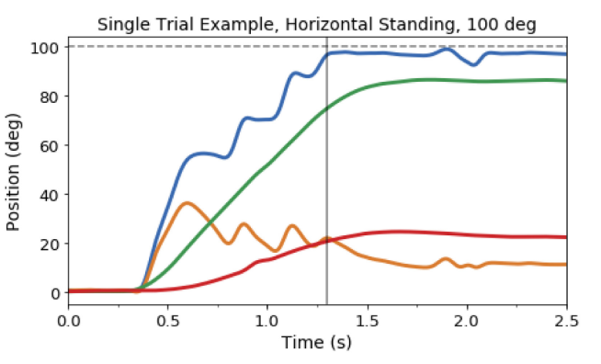
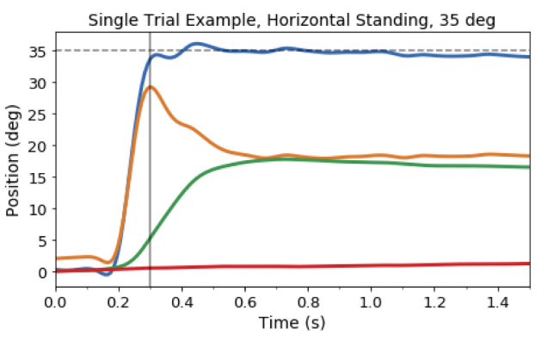
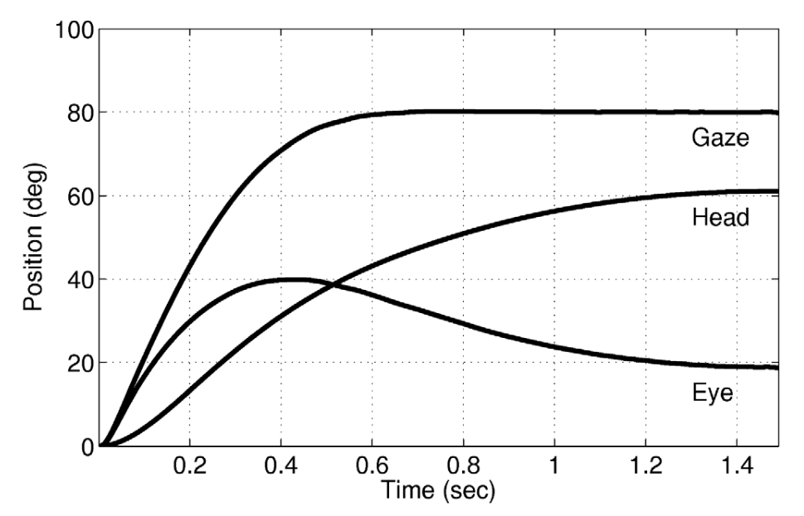
Gaze Multimodal
Sidenmark and Gellersen (2020) [15] describes very well the concept that gaze is multimodal (Fig 4, Fig 3 ). Gaze involves not only the eyes but also head and torso movements. The gaze shift is of 90° of amplitude in the graph it can be observed that the eyes amplitude increments until it reaches 40° , once the head rotation reaches a similar amplitude the eyes starts readjusting lowering their amplitude to a more comfortable position such as 15°. In both studies of Saeb (2011) and Sidenmark (2019) during gaze shifts there is no negative contribution of eyes or head registered. The fact that no negative contributions are registered means that during gaze shifts whenever the head rotate towards the left side the eyes also end up contributing towards the same rotation direction.
[15] L. Sidenmark and H. Gellersen.Eye, Head and Torso Coordination DuringGaze Shifts in Virtual Reality.ACM Transactions on Computer-Human Inter-action, 27(1):1–40, 1 2020.ISSN 1073-0516.doi:10.1145/3361218.URLhttps://dl.acm.org/doi/10.1145/3361218.
[13] S. Saeb, C. Weber, and J. Triesch. Learning the optimal control of coordinated eyeand head movements.PLoS Computational Biology, 7(11), 2011. ISSN 1553734X. doi:10.1371/journal.pcbi.1002253.

Slide 5
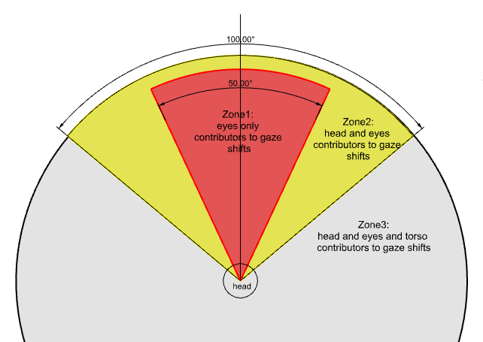
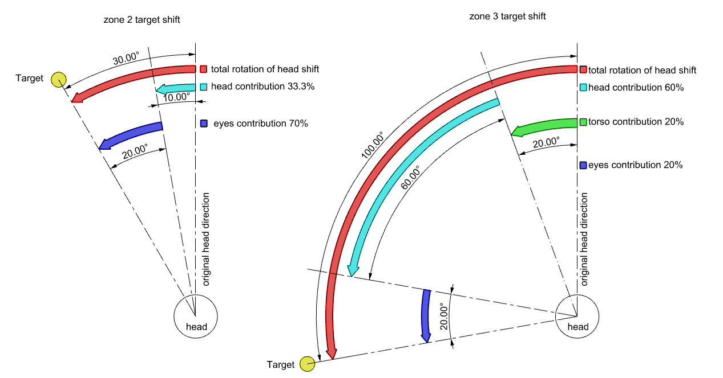
Gaze Zones
Sidenmark and Gellersen (2020) [15] carries out a study which results supports the introduction of the concept of 3 amplitudes of gaze zones:
gaze shifts up to 25°that can be comfortably achieved eyes-only;
gaze shifts in the range 25–50°, where eyes and head together reach targets comfortably;
and gaze shifts over amplitudes larger 50°where eyes, head and also torso need to work together for comfortable viewing.
[15] L. Sidenmark and H. Gellersen.Eye, Head and Torso Coordination DuringGaze Shifts in Virtual Reality.ACM Transactions on Computer-Human Inter-action, 27(1):1–40, 1 2020.ISSN 1073-0516.doi:10.1145/3361218.URLhttps://dl.acm.org/doi/10.1145/3361218.

Slide 6
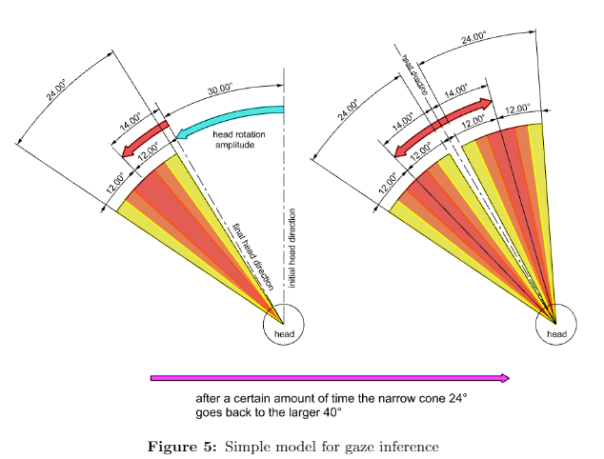
Simple model
Eyes and head contribution are always positive towards gaze shifts the following approach could be considered with the purpose of refining the visual cone. Once the head rotate towards the right side the eyes will have a mean amplitude of 14°±12°onthe right in relation to the head direction [16]. The same apply for the left side. However, such cone validity might have a short duration span as the body pose can quickly readjust in order to stabilize the gaze in a comfortable position. Once the body pose adjust and the head stops moving the gaze behavior will start to depend on eyes movement and therefore lying anywhere within the cone of vision of 40°(see Fig 5). In Fig 5 we display the described approach. Such approach could reduce the cone of vision of half (i.e., from 48 to 24) whenever a head shift happens. Since a recent study comparing eye–head coordination in virtual versus physical reality observed that display limitations induce more head movement in VR [11] we expect such model to drastically reduce the cone of vision displayed and therefore enable users to have a less ambiguous awareness of a collaborators view.

Slide 7
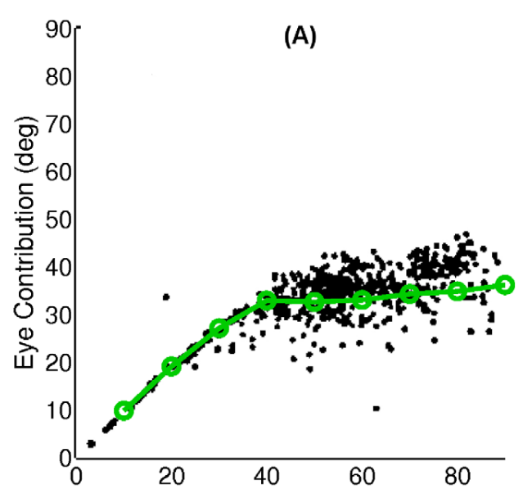
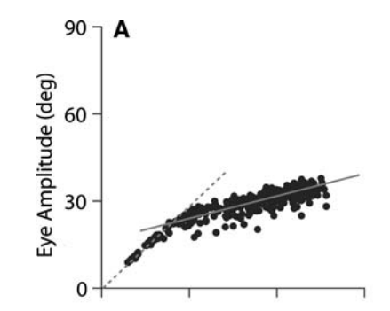
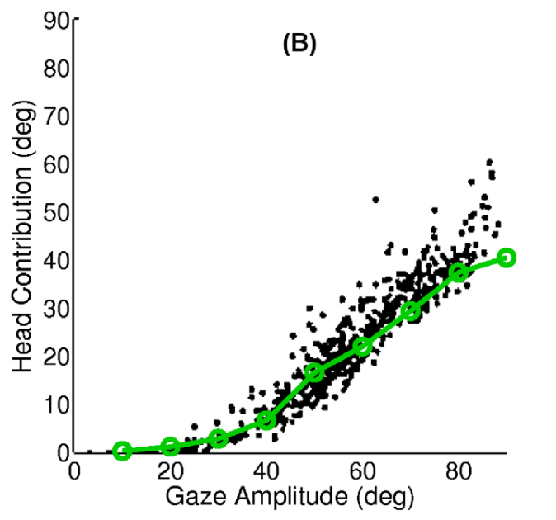
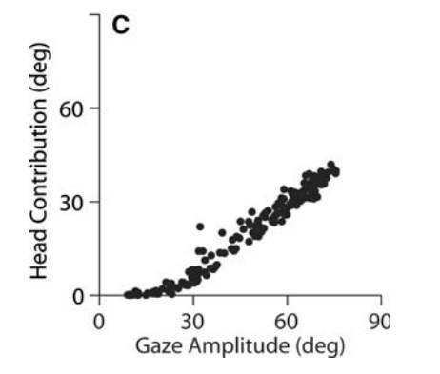
Head contribution
Previous research explore the concept of head contribution and eyes contribution towards gaze amplitude. In natural tasks, the head contributes about to gaze shifts of up to 30°, and more to gaze shifts that are larger [13] (Fig 7). However, the head contribution became more substantial as the target amplitude increased, reaching up to 60% contribution at 100° [14]. This means that if we detect a horizontal head shift towards the right side of 20° the gaze is likely to be 30° to the right of the head direction at the end of the head shift. Such prediction is inline with Sitzmann et al. (2016) [16] measures (Fig 1b).
[13] S. Saeb, C. Weber, and J. Triesch. Learning the optimal control of coordinated eyeand head movements.PLoS Computational Biology, 7(11), 2011. ISSN 1553734X. doi:10.1371/journal.pcbi.1002253.
[15] L. Sidenmark and H. Gellersen.Eye, Head and Torso Coordination DuringGaze Shifts in Virtual Reality.ACM Transactions on Computer-Human Inter-action, 27(1):1–40, 1 2020.ISSN 1073-0516.doi:10.1145/3361218.URLhttps://dl.acm.org/doi/10.1145/3361218.
[16] V. Sitzmann, A. Serrano, A. Pavel, M. Agrawala, D. Gutierrez, B. Masia, andG. Wetzstein.How do people explore virtual environments?2016.URLhttp://arxiv.org/abs/1612.04335.
[6] E.G.Freedman.Coordinationoftheeyesandheaddur-ingvisualorienting,102008.ISSN00144819.URL/pmc/articles/PMC2605952/ /pmc/articles/PMC2605952/?report=abstracthttps://www.ncbi.nlm.nih.gov/pmc/articles/PMC2605952/.
[13] 2015
[6] (2015)

Slide 8
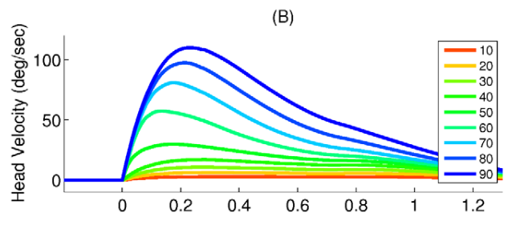
Head velocity
During head shift peak head velocity can contains information that can be insight full in regard to gaze shift amplitudes. Saeb et al. (2011) [13] measure how head rotation velocity in degree/s variate depending on the target angle(Fig 6), a peak velocity of 120 degree/s means that the target is at 90°and very low peak velocity 25 degree/s means that the target is at 50°angle. Overall head shift movement duration reported by Saeb is approximately 1 second from the peak speed.
[13] S. Saeb, C. Weber, and J. Triesch. Learning the optimal control of coordinated eyeand head movements.PLoS Computational Biology, 7(11), 2011. ISSN 1553734X. doi:10.1371/journal.pcbi.1002253.

Slide 9
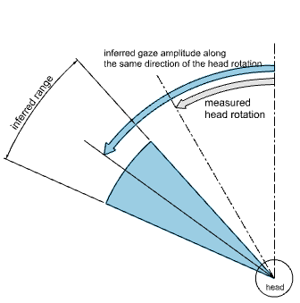
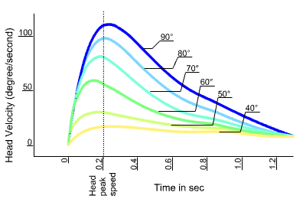
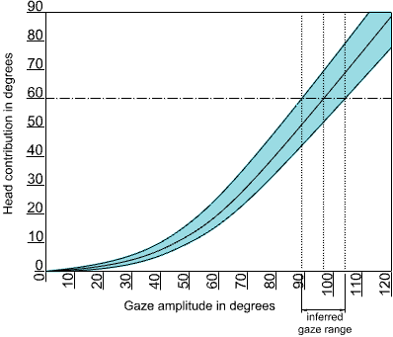
Model based on Head contribution and Velocity
A head shift of 10°will correspond to a gaze shift of 40°6). Additionallyto predict amplitude we can measure amplitude once head velocity drops to0 degree/sec.With both predicted and measured head shift amplitude we caninfer the corresponding range of gaze amplitudes (Fig 7). The direction of headrotation (left or right) can then be extended to the upper and lower limit ofthe gaze amplitude range. Such cone of vision validity however might be quiteshort in time as user will then readjust their posture to stabilize the gaze in acomfortable position and then being able to further explore the area of interestwithin the usual 40°. As there are no current studies which explore how quicklya head shift is readjusted we consider the validity of the narrower cone of visionto be around 1 sec max after which it should fade away or return to the larger40°cone of vision.

Slide 10
Head + Eye Gaze dataset
https://web.gin.g-node.org/ioannis.agtzidis/
[1] I. Agtzidis, M. Startsev, and M. Dorr. 360-degree Video Gaze Behaviour: A ground-truthdata set and a classification algorithm for eye movements. Technical report, 2019. URLhttps://www.tobiipro.com/product-listing/tobii-pro-glasses-2/.
Both model can be tested using this dataset.
Measures will be:
Accuracy
How much the model reduce area of the cone of vision

Slide 11
Validation with users
Further validation with a user study could take place to understand how themodels affect mutual understanding of view. For example the study could askusers to perform a collaborative task across 3 different experimental conditions:9
FOV visualization as a first condition 100°
visual cone 40°-50°
0models (dynamically reducing the range and amplitude of the cone basedon head movements)
The collaborative task could be based on the work of Wong and Gutwin(2014) [18] which carries out a study on pointing based communication in semiimmersive VR. Wong ask participant to work on three creative tasks. Duringthe tasks, pairs collaboratively constructed stories and made decisions basedon scenarios given to them. For example Wong uses a visualization of a cityand ask participants to pretend to be roommates and to look for an apartmenttogether, taking into consideration issues such as type of neighborhood, distanceto work sites, and traffic. These tasks involved referencing and pointing fromboth participants, and were open-ended with no defined solution.Upon completion of each of the tasks we could measure how effectively themodels were in supporting mutual awareness of visual focus via questionnairesand open interviews as well as we could rate each of the conditions with theSystem Usability Scale. Behavioural measure such as:
The amount of shared focus [3];
Amount of verbal communication during collaboration [3];
Number of times pointers are used: higher mutual awareness of visualfocus could impact how much participants use hand pointers.

